Slide 1
Stratifying ROSMAP patients with archetype analysis*
Annat Haber
Lab meeting September 2019

Slide 2
Complex systems need to perform multiple tasks
No system can be optimized for all tasks simultaneously, leading to trade-offs.
Problem: identifying types and the effective number of dimensions
Notes:
The basic idea of archetype analysis is that complex systems need to perform multiple tasks and no system can be optimized for all tasks at the same time. That leads to trade-offs, or compromises, which manifest themselves as different types in the multidimensional space.
So if we think about eco-morphology: we have here herbivores that are optimized to eating plants and faunivores that eat only other animals. Every phenotype along this line represents a compromise that is best suited to a specific combination of diets along this spectrum.
And if we think about gene expression, each type of cells has a specific gene expression profile that reflects specific physiological task that this cell type performs best.
The basic problem here is, as always, to identify these types as discrete entities given a continuous high-dimensional space and in this way determine the effective number of dimensions. This is usually approached some factor analysis like PCA or k-means clustering etc.

Slide 3
Complex systems need to perform multiple tasks
No system can be optimized for all tasks at the same time, leading to trade-offs.
Apply the Pareto front concept to find the number of tasks and position of their respective archetypes
Classify individuals based on their ability to perform each of the tasks
Notes:
Thinking about this problem from a biological perspective has led Alon et al to apply the Pareto front concept/algorithm in order to find the number of tasks and then classify the individuals based on their ability to perform each of those tasks.
To put it in the simplest terms, this method is a kind of factor analysis, but while PCA uses orthogonality as a criterion for decomposing the variance, and k-means minimizes variance within vs among clusters, this method looks to identify the extremes in the data, called archetype.

Slide 4
Complex systems need to perform multiple tasks
No system can be optimized for all tasks at the same time, leading to trade-offs.
The fitness function is a linear combination of the ability of a given phenotype v to perform each task
F(v) = f_{h}(p₁(v), p₂(v), …, p_{k}(v)) (Arnold 1983)
The performance of each task is weighted by how important it is for a particular niche
The Pareto front is the set of best compromises
Each point along the Pareto front is a niche
Phenotypes off the front are outperformed and eliminated
Notes:
And why is this algorithm more biologically-meaningful? Because it is based on the fitness function being a linear combination of the ability of each phenotype to perform each task.
This f tells us how much each task is weighted based on how important it is for a particular niche, so the ability to break down cellulose will be weighted as zero for a carnivore but will be heavily weighted for a herbivore.
This results in what is called the Pareto front, which is the set of best compromises, where each point along this front is a niche. Moving along this front leads to an improvement in some tasks on the expense of the others. Phenotypes that fall off this front are by definition outperformed by those on the front and therefore get eliminated by selection.

Slide 5
F(v) = f_{h}(p₁(v), p₂(v), …, p_{k}(v))
(Arnold 1983)
Notes:
Illustrating why phenotypes off the Pareto front are outperformed by those that are on the front.
Here we have a space of two tasks represented by two traits. Each task on its own is best performed by a specialist that we call here archetype. The Pareto front here is the straight line connecting the two archetypes. Why? Because we define the fitness function as a linear combinations of the task performances, and the performances decrease with distance from their respective archetypes
Basically another way of saying that the shortest line between two points is a straight line… In a metric space of two tasks, any point that is off the line would necessarily have a longer distance overall from the archetypes, and therefore lower total fitness.

Slide 6
Assumptions:
For each task there is a single phenotype that maximizes performance for that task (the archetype)
Performance decays monotonically with distance from archetype
All performance functions decay with the same norm from their maxima
Predictions:
The Pareto Front of complex systems is a convex hull (polytope)
Archetypes are the vertices of the polytope
The effective dimensionality of the system is k – 1; where k is number of archetypes
No matter how many traits represent the system, naturally-selected phenotypes will fall on a polytope within a low-dimensional space based on the number of tasks

Slide 7
Example: Single-cell gene expression data from human colon crypt cells
K = 4
D = K-1 = 3
Four vertices (Tetrahedron) explains 45% of the variance
Three PC’s explain 95% of the variance
Distributed kinda sort of like a tetrahedron
Notes:
Looking at an example from their paper:
They analyze single-cell expression data from human colon crypt cells, and calculated the variance explained by the best-fit polytopes that encompass the data, starting with 2 archetypes, basically a line, and adding one vertex at a time. They find that the first bend in this curve yields 4 vertices, so a tetrahedron, explaining 45% of the variance. The classical PCA scree plot also shows 4 significant dimensions, where the first 3 explain 95% of the variance and the forth doesn’t really add much, so effectively 3 dimensions as predicted. And the data distribution in these 3 dimensions actually does look a bit like a tetrahedron.

Slide 8
Example: Single-cell gene expression data from human colon crypt cells
Each of the archetypes shows high expression of a set of markers typical of a specific crypt cell type
Notes:
Looking at the expression profiles of points closest to each of the vertices we can infer the biological function of each archetype, and we can see here that it does match the expectation based on the cell types that we know exist in this example based on specific markers

Slide 9
Main attributes and advantages:
The orientation of the archetypes does not generally align with the PC’s, implying that the biological meaning of the archetypes is distinct from that carried by the PCA components.
Less sensitive to sampling error
Avoids the problem of determining cluster boundaries that are usually fuzzy
Reducing dimensionality beforehand is not necessary
Small sets of genes (traits) with small but biologically-relevant effect will be lost
Notes:
They analyzed several datasets from different biological contexts in a series of papers.
To summarize the important points that they found:
First and foremost: The orientation of the archetypes does not generally align with the first PC, implying that the biological meaning of the archetypes is distinct from that carried by the PCA components.
Hyperspectral unmixing algorithms for determining the position of the archetypes. And the elbow in the explained variance function to identify the number of dimensions. 5 different algorithms are implemented in their Matlab package.
In addition:
Less sensitive to sampling error
Avoids the problem of determining cluster boundaries that are usually fuzzy
Reducing dimensionality with PCA beforehand is not necessary
But:
Small sets of genes (traits) with small but biologically-relevant effect will be lost (a follow-up paper tries to work around it by giving different weights to different genes based on a priori knowledge of their relevance)
(Also, can calculate the clumpiness of the data by the ratio of local density of the data to that expected for a randomized dataset [Korem et al])

Slide 10
Find archetypes of AD patients (ROSMAP cohort)
Extract “typical” gene expression profiles (~modules)
Compare with current (sub)modules
Map distance from archetypes onto WGS
Notes:
What I propose to do

Slide 11
Model-AD pipeline
Milind et al. in review
Notes:
This is the pipeline currently used by the Model-Ad group on the AMP-AD datasets. Most of this work was done by Nikil Milind in our lab, based on the modules that Ben Logsden has generated.

Slide 12
Mayo
MSBB
ROSMAP
(N=623)
Notes:
As a reminder: we have three cohorts, Mayo clinic, Mount Sini Brain Bank, the ROS/MAP study. They each include patients from all stages of the disease, and differ greatly in their population structure, study design, etc. The largest and most homogeneous dataset is ROSMAP with a total of 623 patients who have both WGS data and RNA-seq data.
In the first round of this study there were three subtypes found, 2 big ones and 1 small one, but the third one was too small, so in the second round it was dismissed. As I’ll show you in a second, using the archetype analysis we were able to recover that third subtype with more even sample sizes for each of the subtypes and a distinct gene expression profile for each of them.

Slide 13
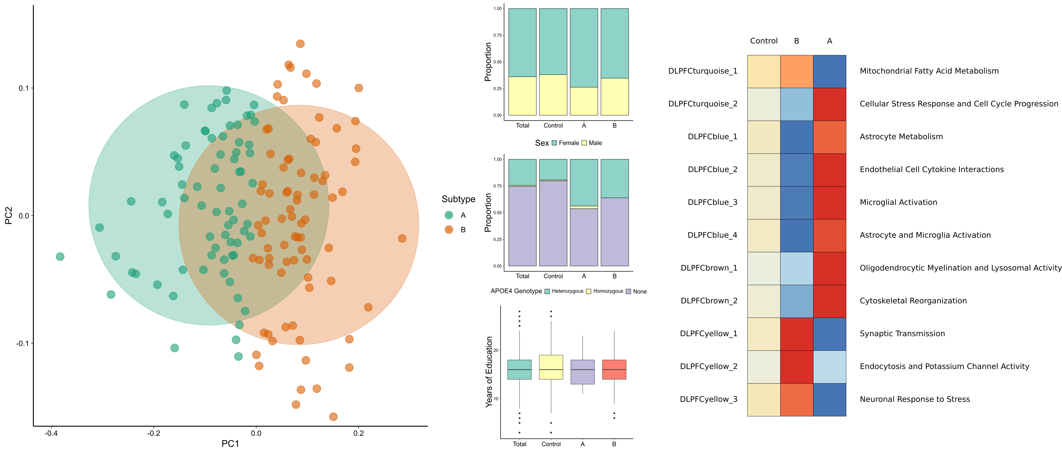
Notes:
This is the second round, based on two subtypes only. You can see here that subtype A is mostly inflammation + various glial functions, while subtype B is mostly about signal transduction

Slide 14
~ 20 non-random PC’s explain only 17%
~ 400 pc’s explain 80%

Slide 15
3 archetypes explain >50%
4th archetype adds < 5%
3 archetypes based on AD cases only
Notes:
The original papers and R package mostly uses Principal Convex Hull algorithm to fit the polytopes. Other methods are incorporated into Alon et al’s matlab package
Also https://www.alzforum.org/news/conference-coverage/proteomics-uncovers-potential-markers-subtypes-alzheimers

Slide 16
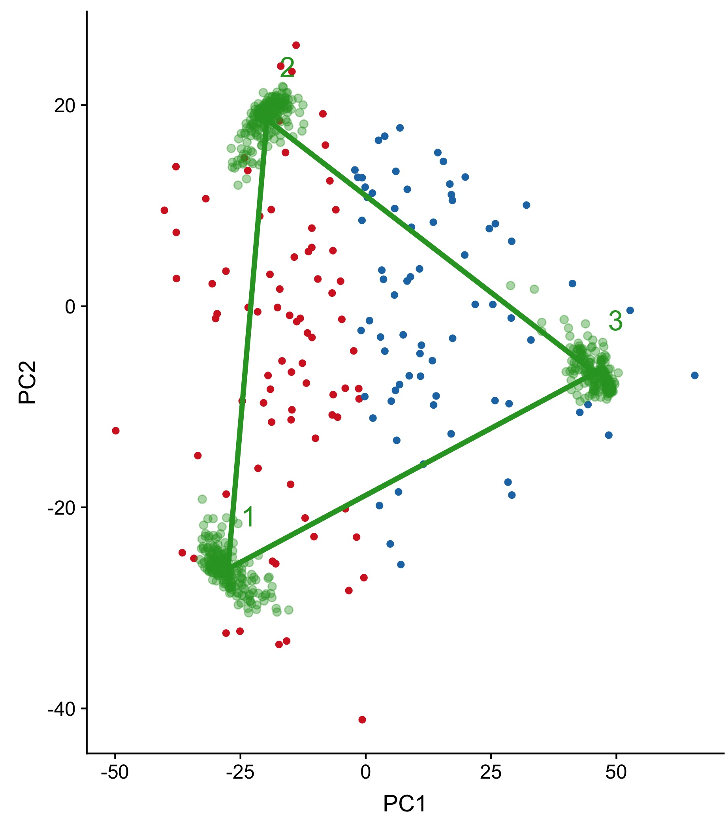
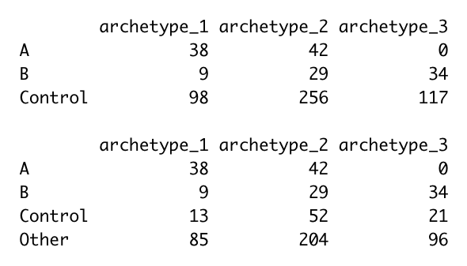
Archetype 3 is all subtype B
Archetype 1 is mostly subtype A
Archetype 2 is a mix
Control and Other are all over
B
A
bootstrap
Notes:
Comparing to Nikil’s subtypes

Slide 17
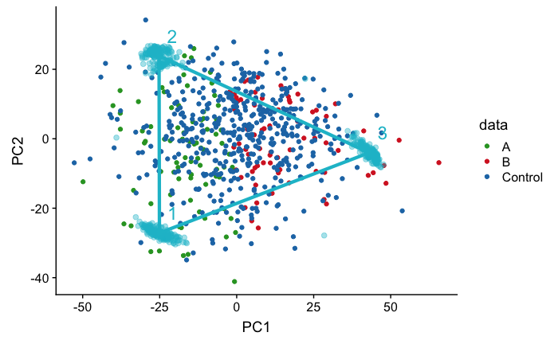

Slide 18
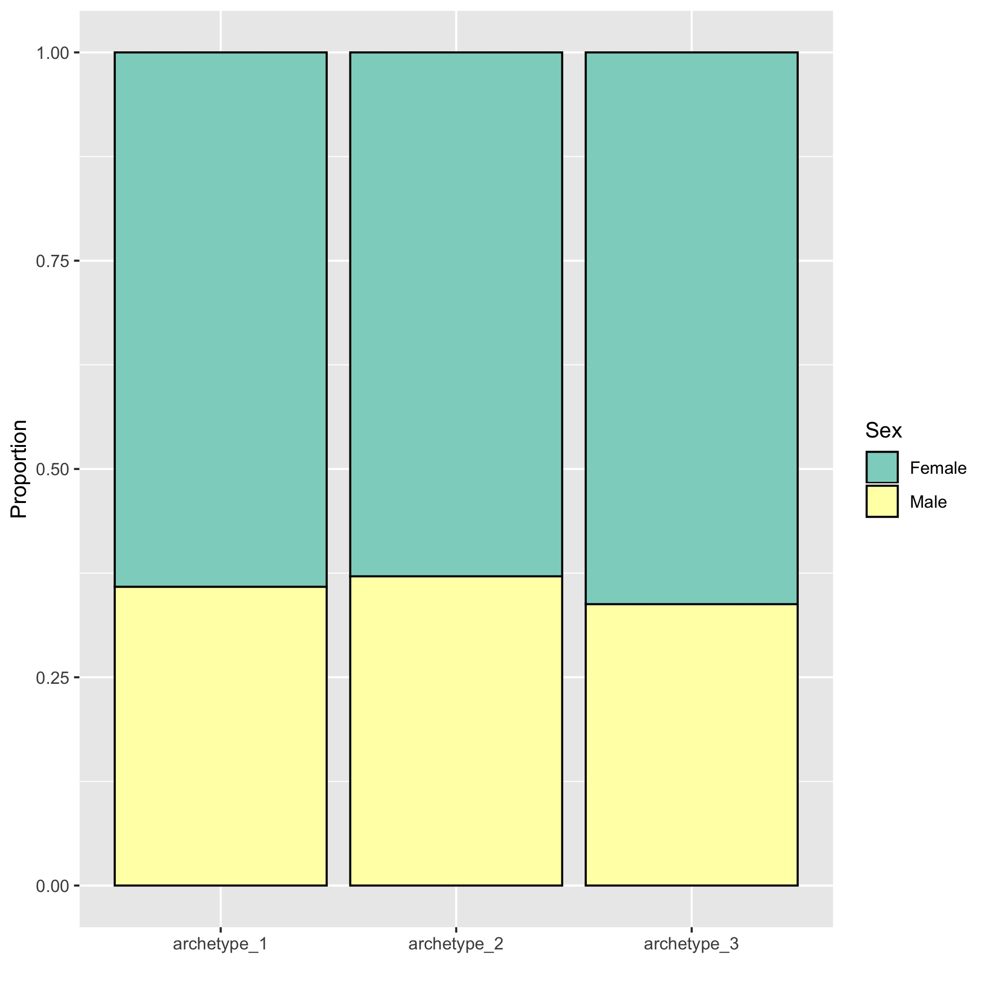
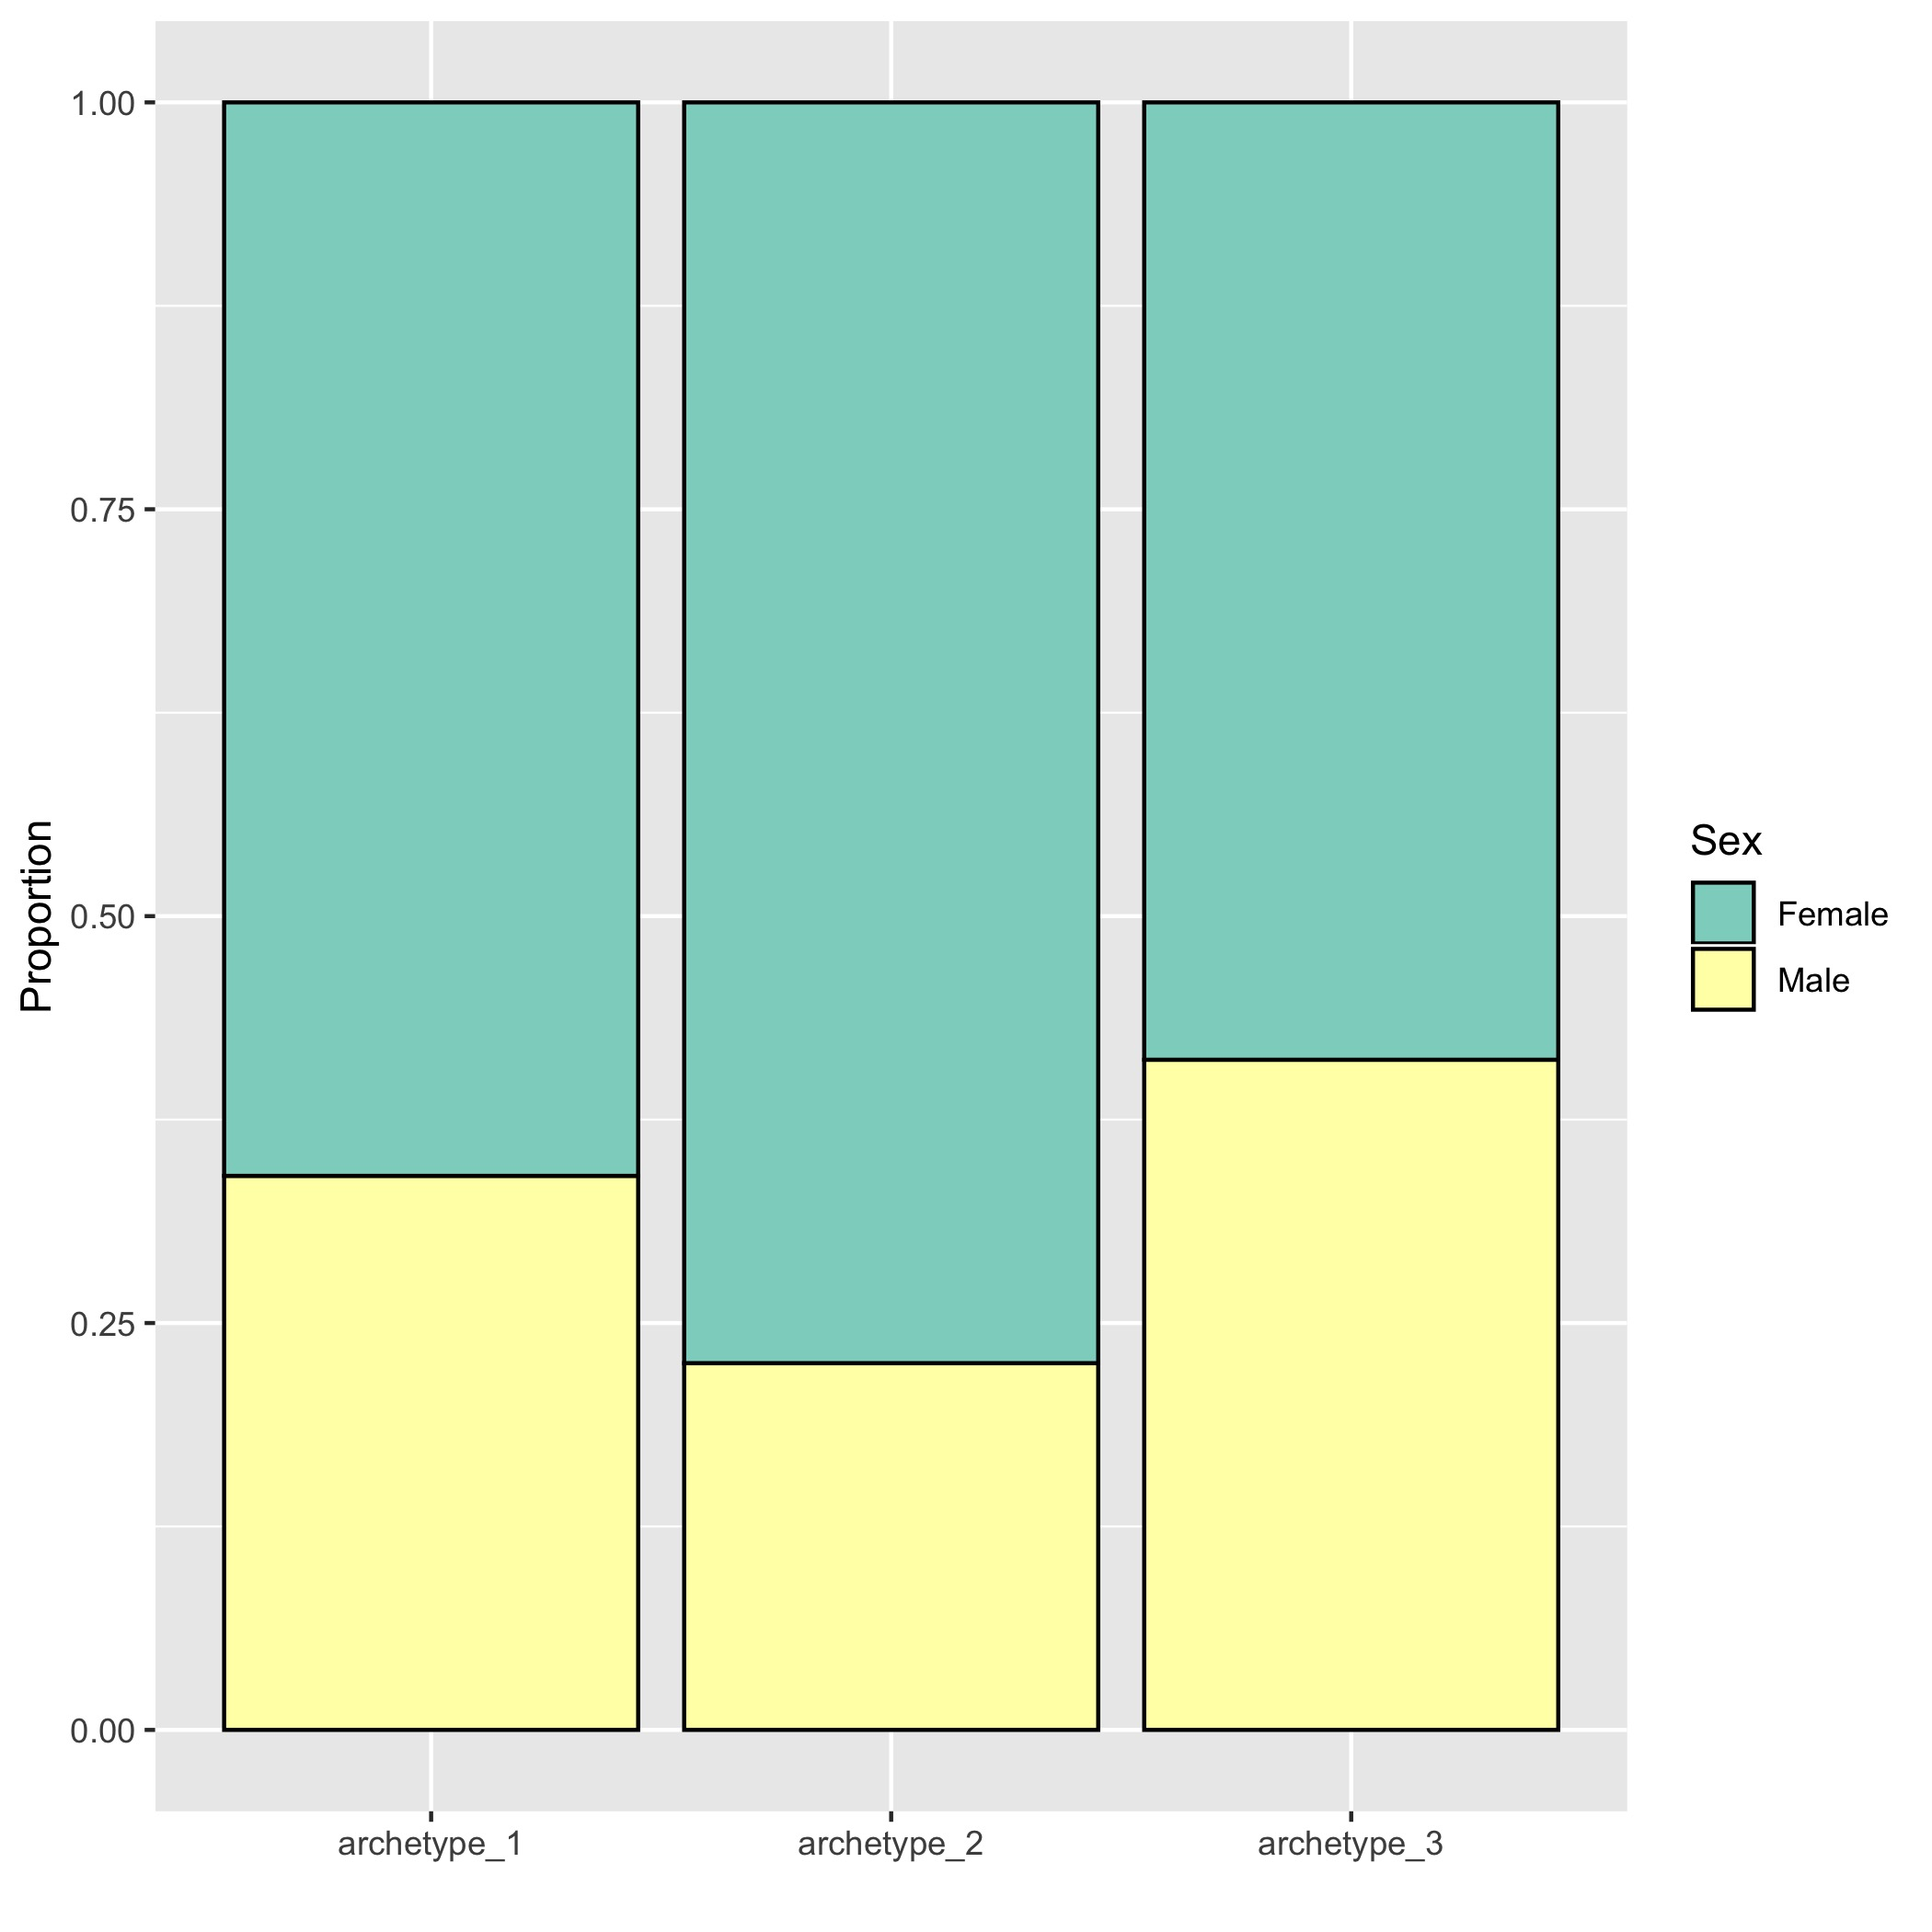
All samples (cases, other, control)
AD patients only
Notes:
Archetype 2 has relatively more females AD patients

Slide 19
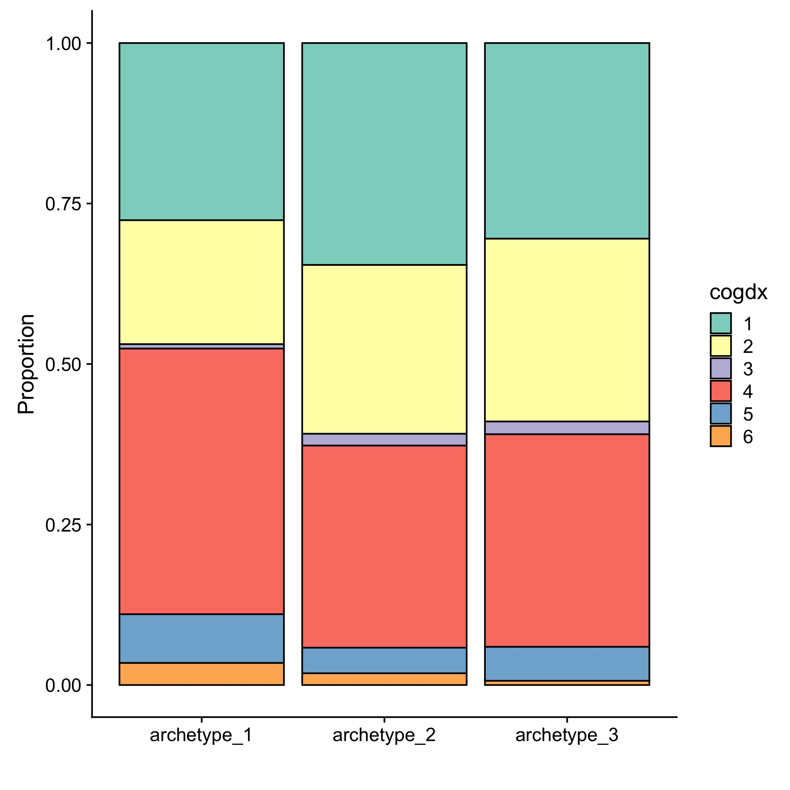
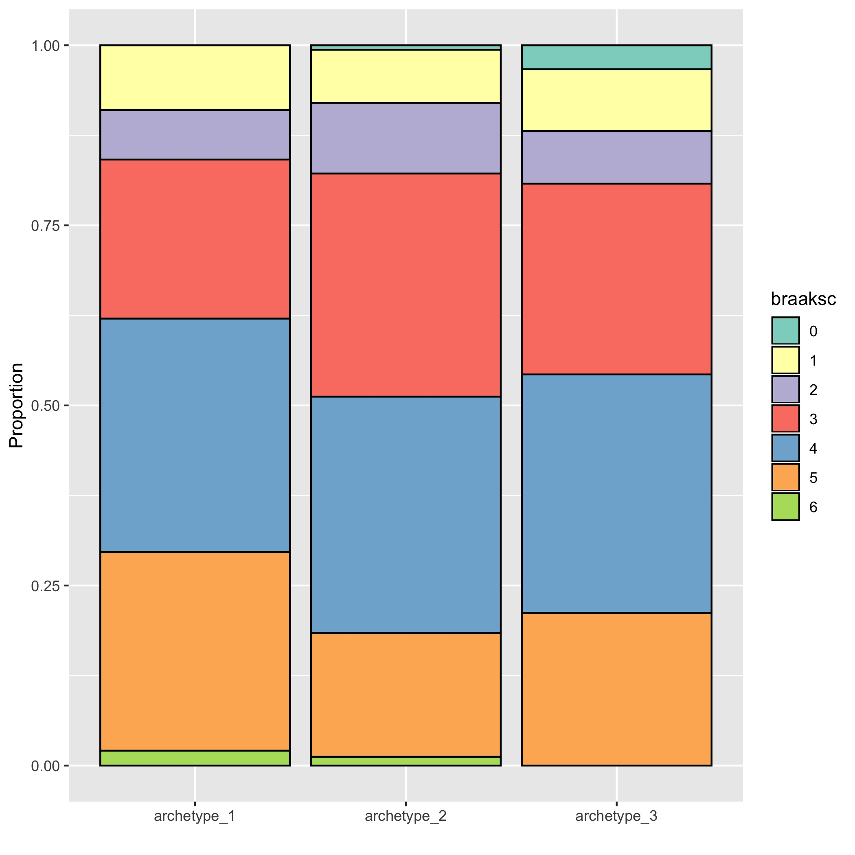
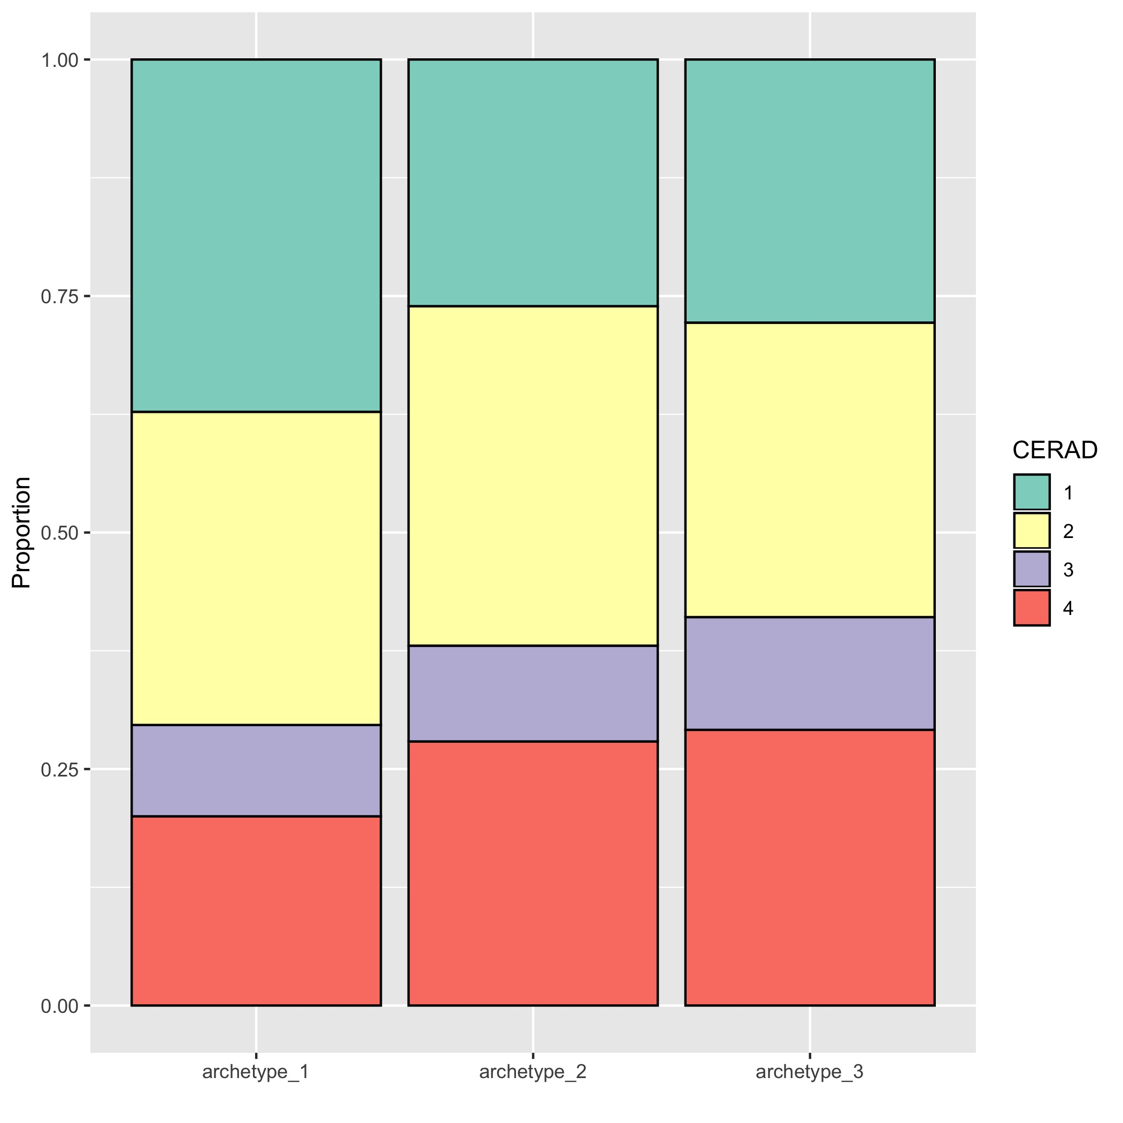
Diagnosis at time of death: Archetype 1 is slightly enriched for AD patients
Cognitive score
Braak
CERAD
------ Control -------
--------- AD -----------
--------- MCI -----------
--------- AD -----------
------ Control -------
--------- AD -----------

Slide 20
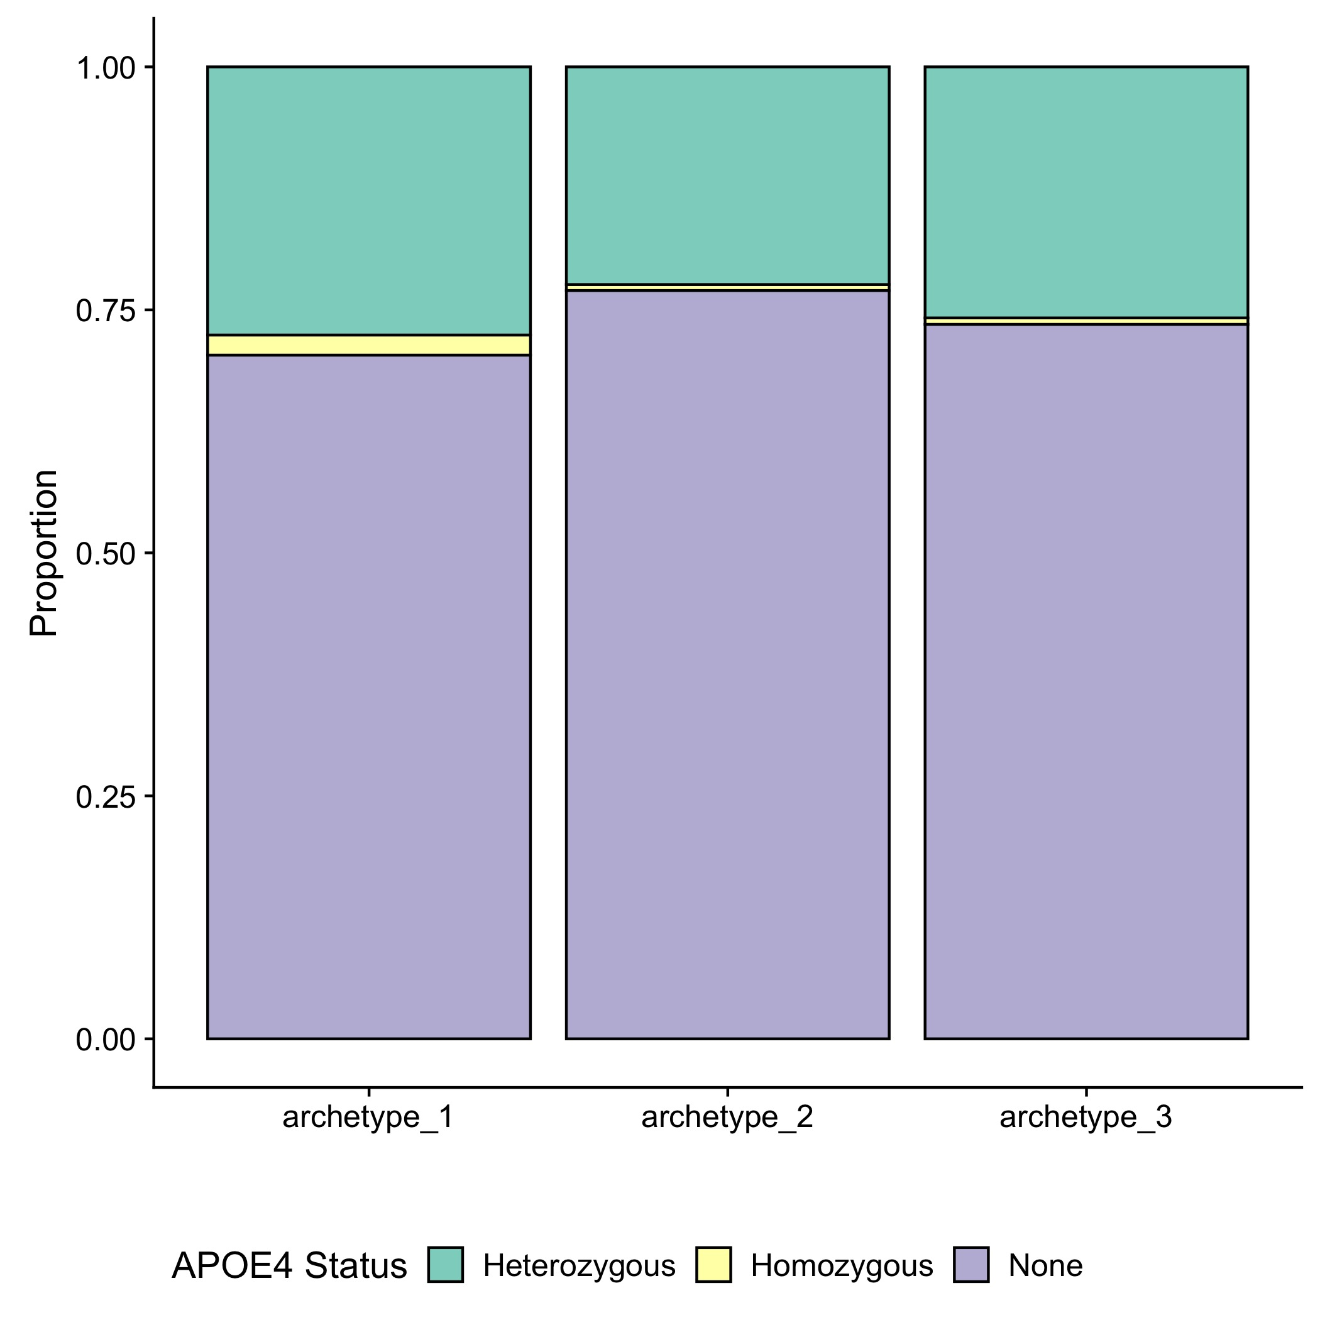
APOE4 status for all samples:
Archetype 1 includes slightly more heterozygotes and homozygotes
Notes:
All samples

Slide 21
Top genes breakdown:
Genes whose expression decreases significantly as a function of distance from an archetype
Archetype 1: 626 genes
Archetype 2: 551 genes
Archetype 3: 1538 genes
Overlap between archetype 1 and 2: 8 genes
Overlap between archetype 2 and 3: 1 gene
Overlap between archetype 3 and 1: None
Notes:
In order to find what genes are associated with each archetypes, the R package includes a function that fits gamma distribution to the expression level of each gene as a decreasing function of distance from each archetype. So the idea is that to find the genes whose expression level decreases rapidly and consistently in individuals that are further away from the archetype.
Out of the ~15000 genes in the original dataset, I found a total of ~2700 genes significantly associated with at least one of the archetypes, with only 8 genes overlap between arch_2 and 1, one gene between 2 and 3, and none between 1 and 3

Slide 22
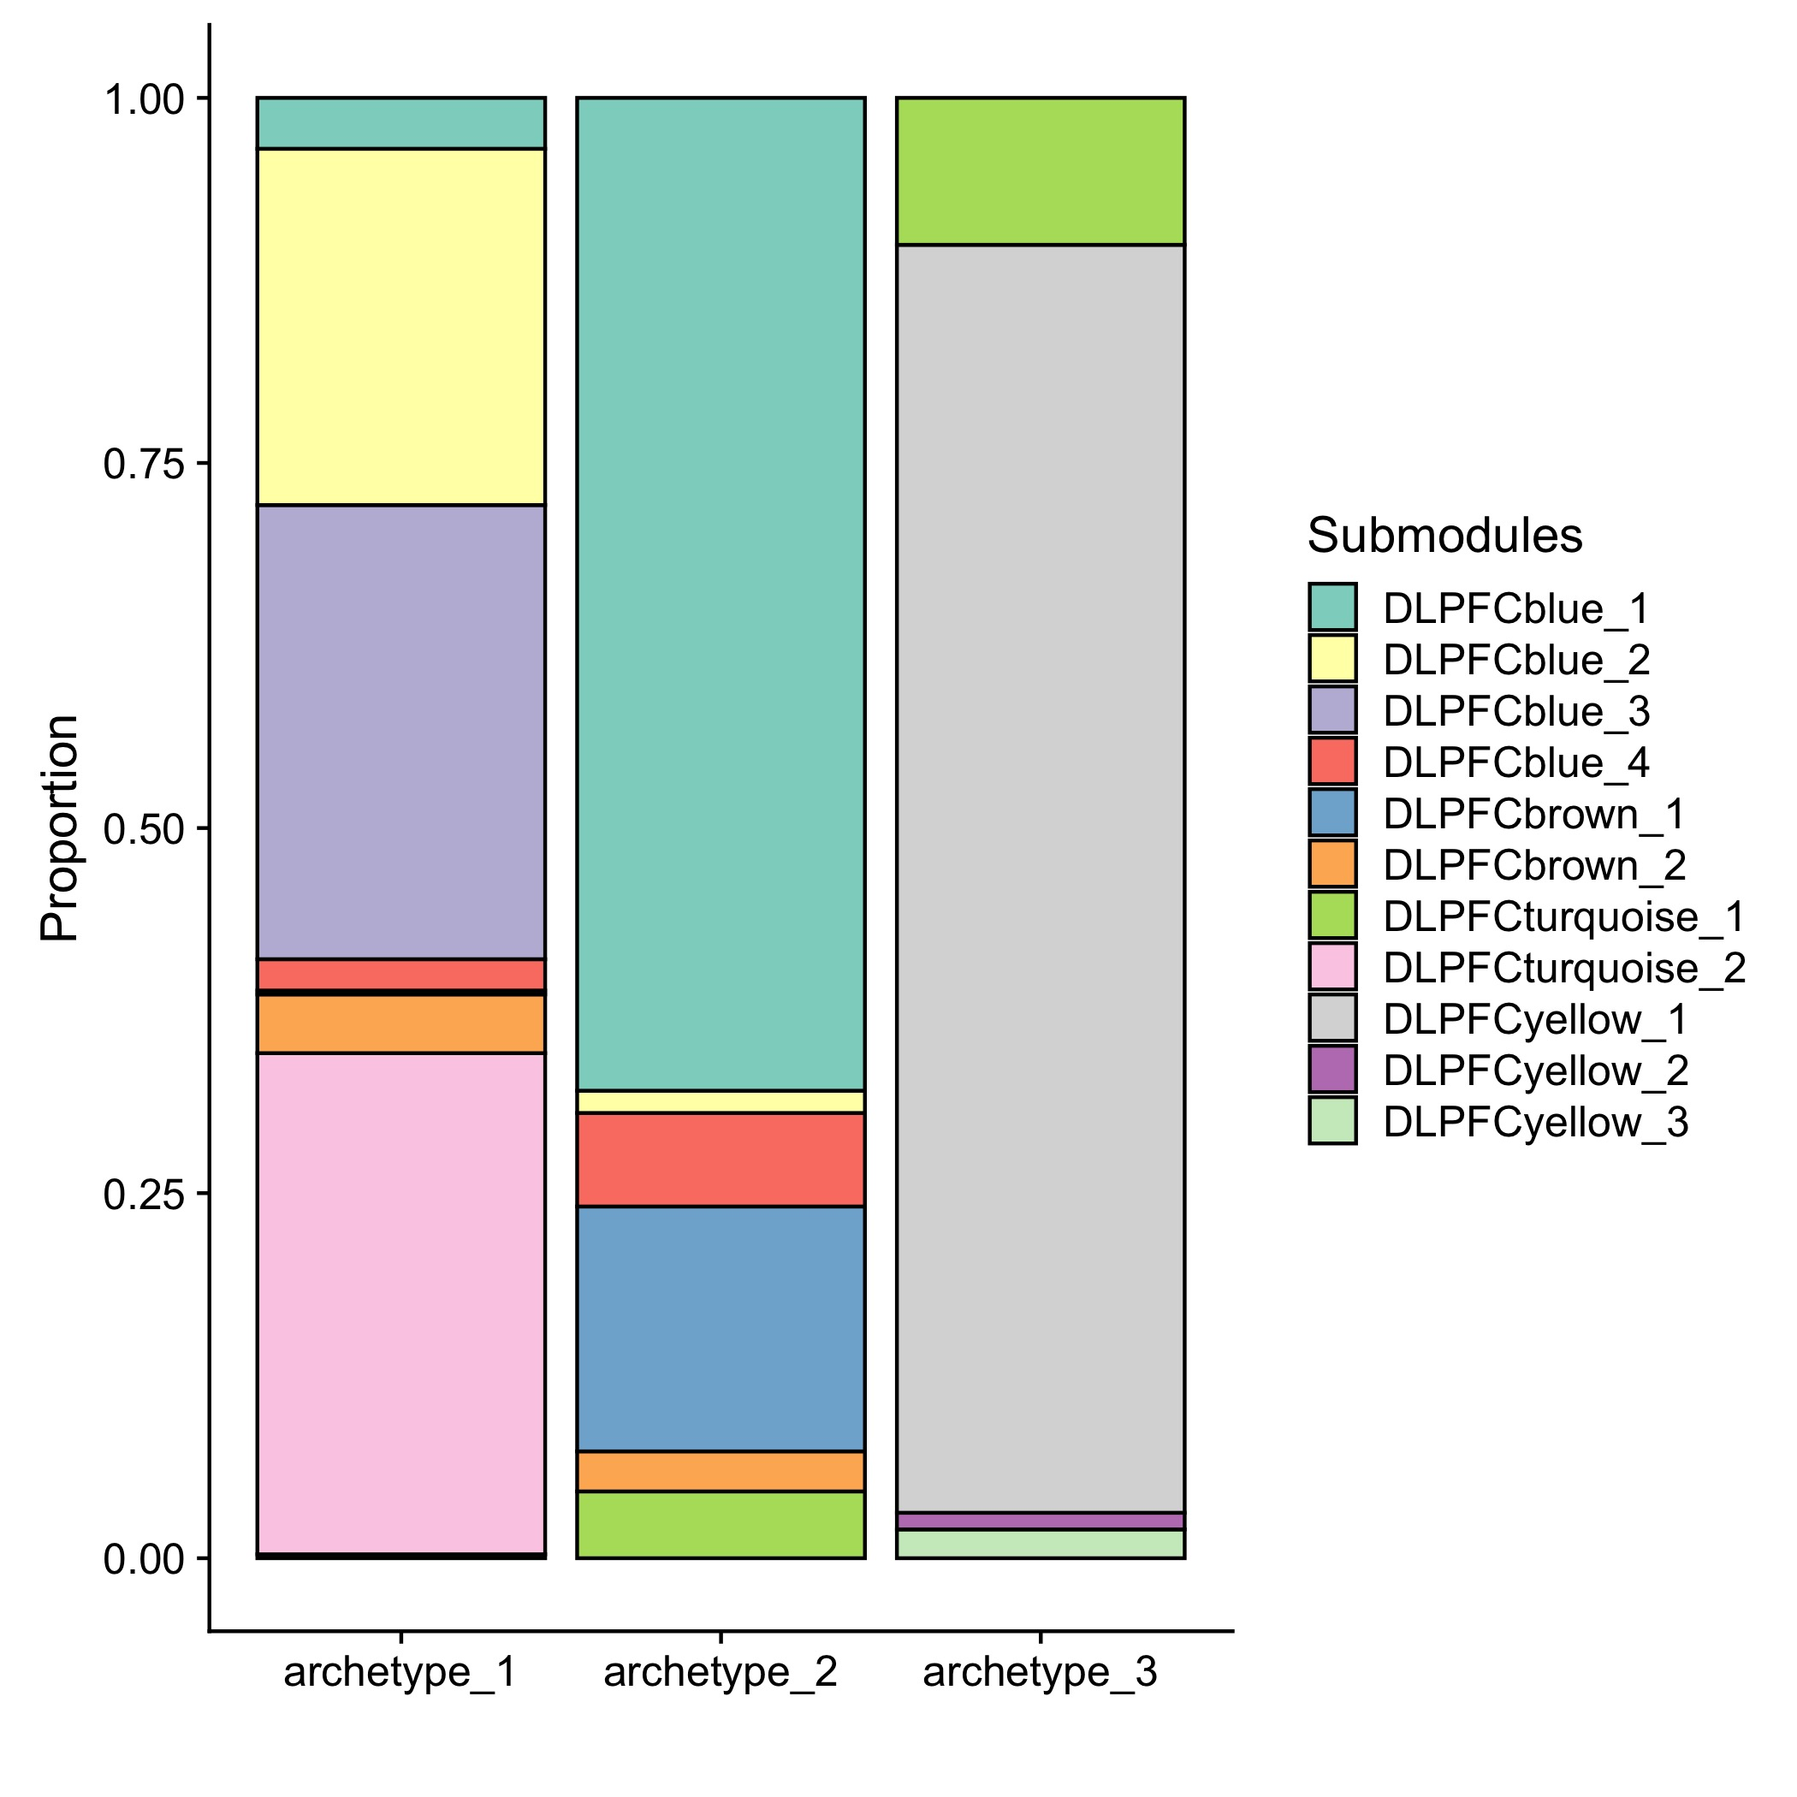
62% of the top genes are included in one of the submodules (80% in big modules)
Ng=626
Ng=551
Ng=1538
cytokine (immune) signaling
inflammatory
DLPFCyellow:neuronal
Synaptic signaling
microglial activation
immune response
protein folding
Stress response
astrocyte metabolism
oxydation-reduction
gliogenesis
oligodendrocytic myelination
A
A+B
B
Notes:
62% of the genes that I found are also in one of the submodules.
The submodule breakdown among the archetypes matches their overlap with the subtypes that Nikhil found.
Arch3 is all yellow, which is strongly enriched for neuronal signature (C).
Arch1 includes all the blues and turquoise2, so basically inflammatory-related (B,E).
Arch2 is again more of a mix – mostly blue1 and brown1 – possibly related to basic functions of glial cells (B,D)

Slide 24
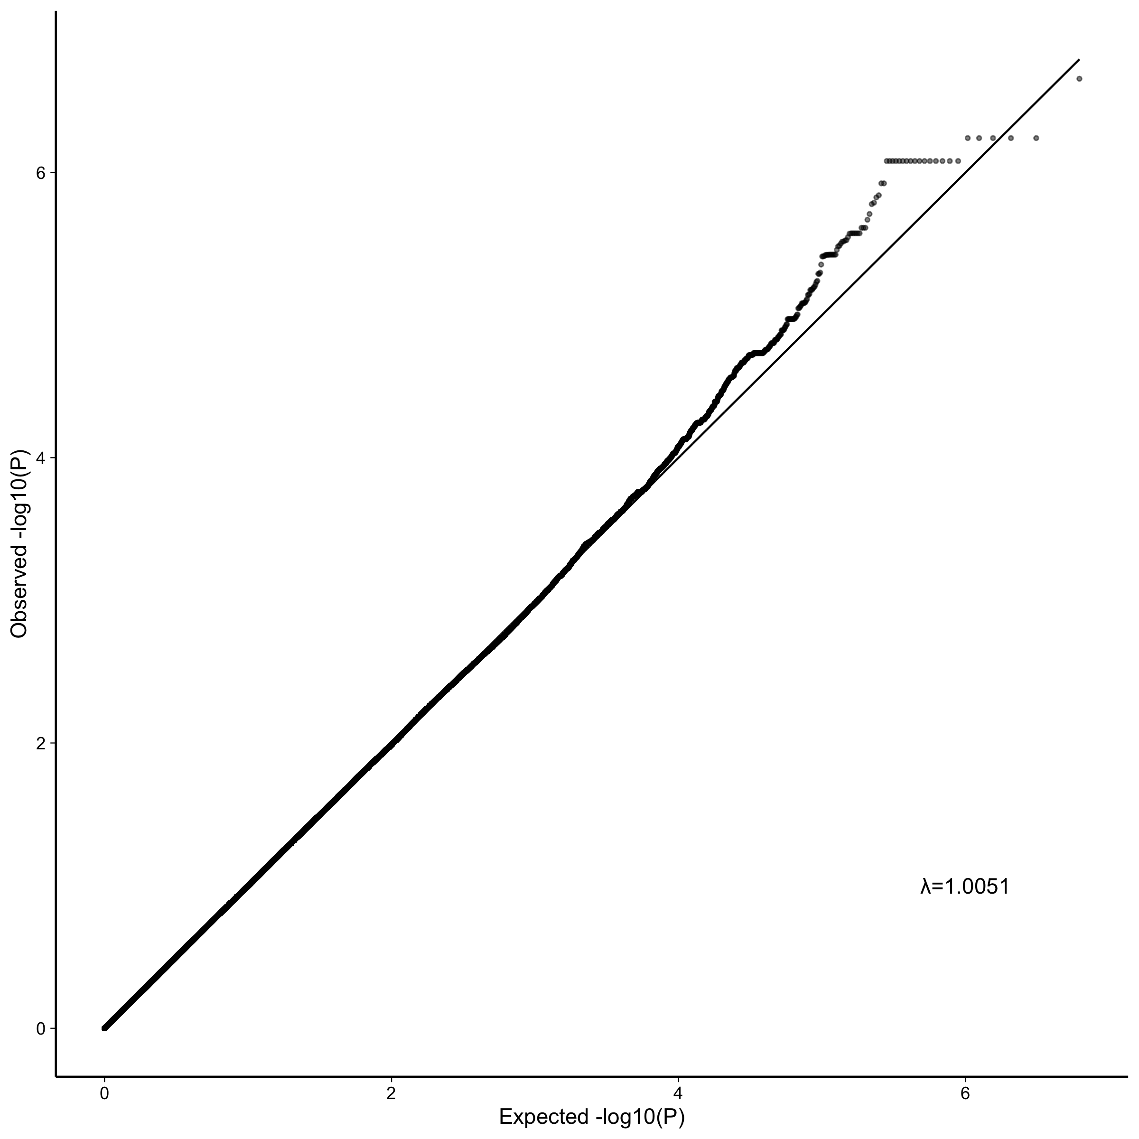
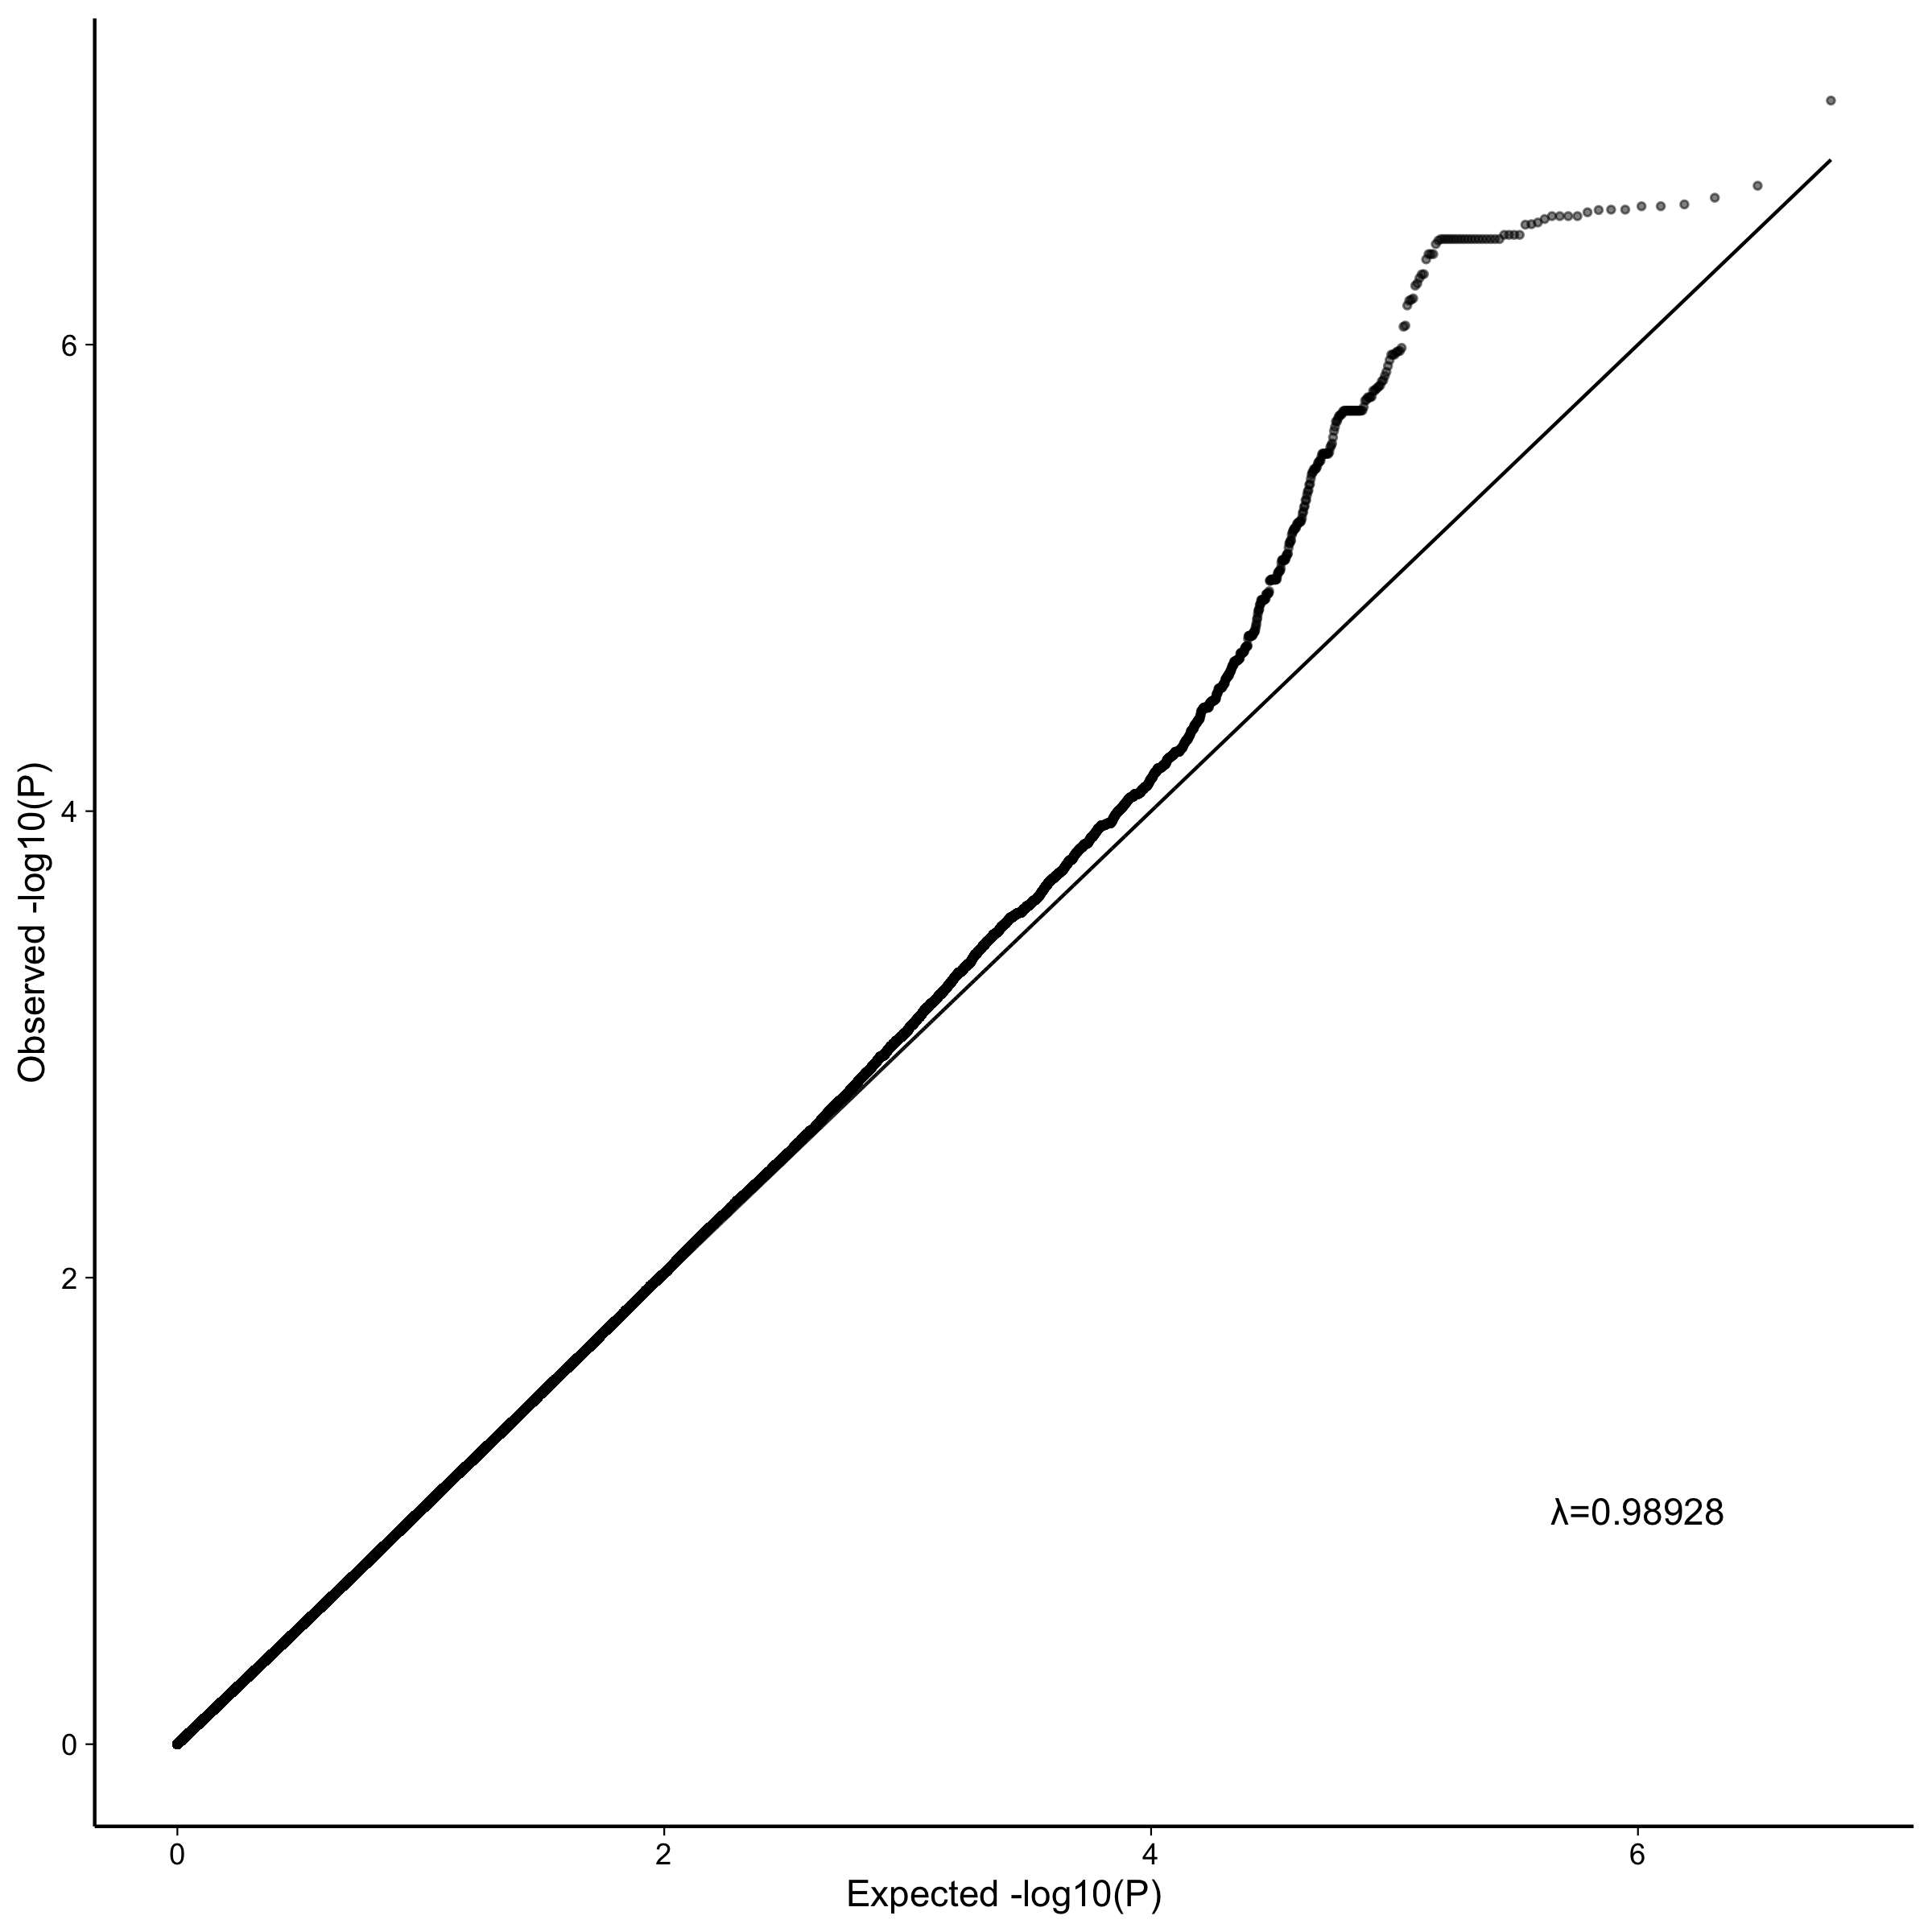
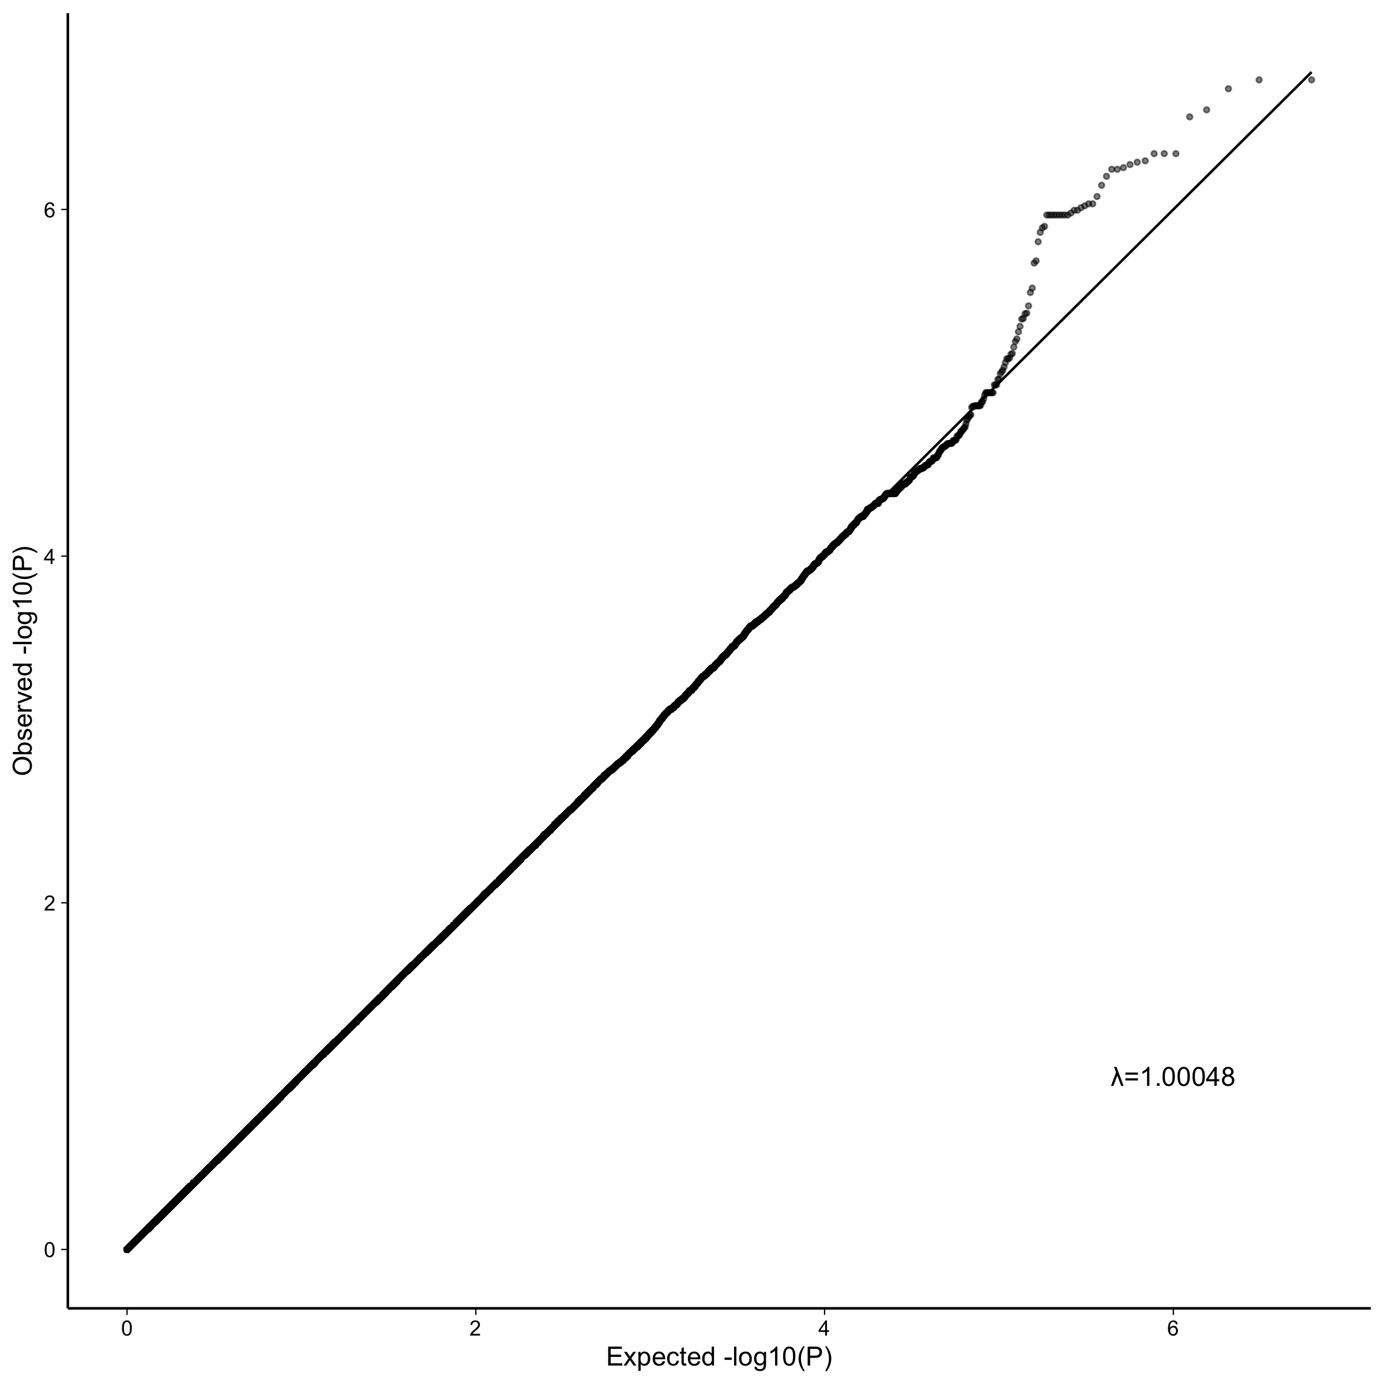
GWAS (EMMAX) of distance from each archetype for all patients (cases and control)
Archetype_1
Archetype_2
Archetype_3
Notes:
For the GWAS, I calculated the distance of each patient from each archetype, including the non-AD patients, so Other and Control. That gives us three different phenotypes for the gwas.

Slide 25
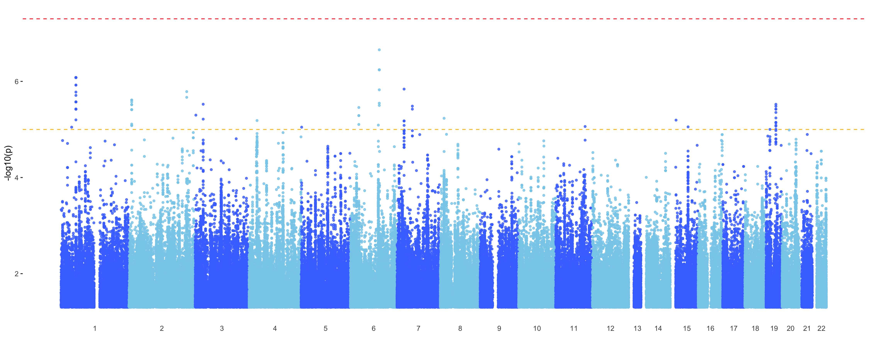
GWAS (EMMAX) of distance from each archetype for all patients (cases and control)
Archetype_1
Notes:
Nothing is significant at the 1^-8 level but plenty are suggestive

Slide 26
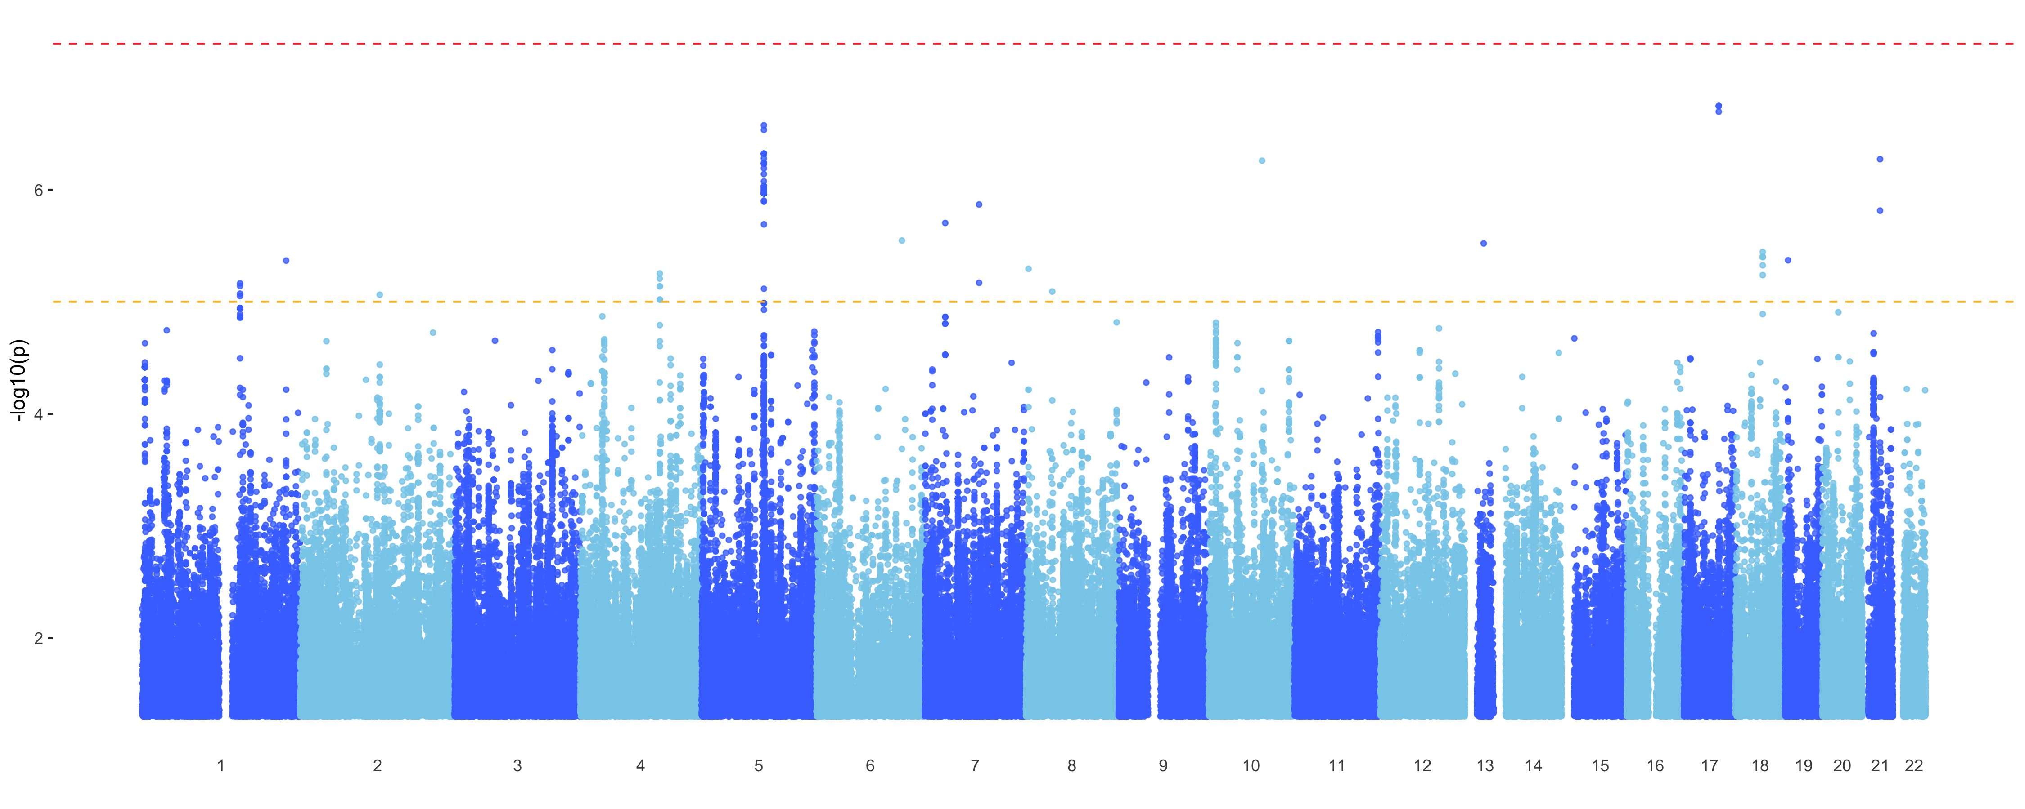
GWAS (EMMAX) of distance from each archetype for all patients (cases and control)
Archetype_2

Slide 27
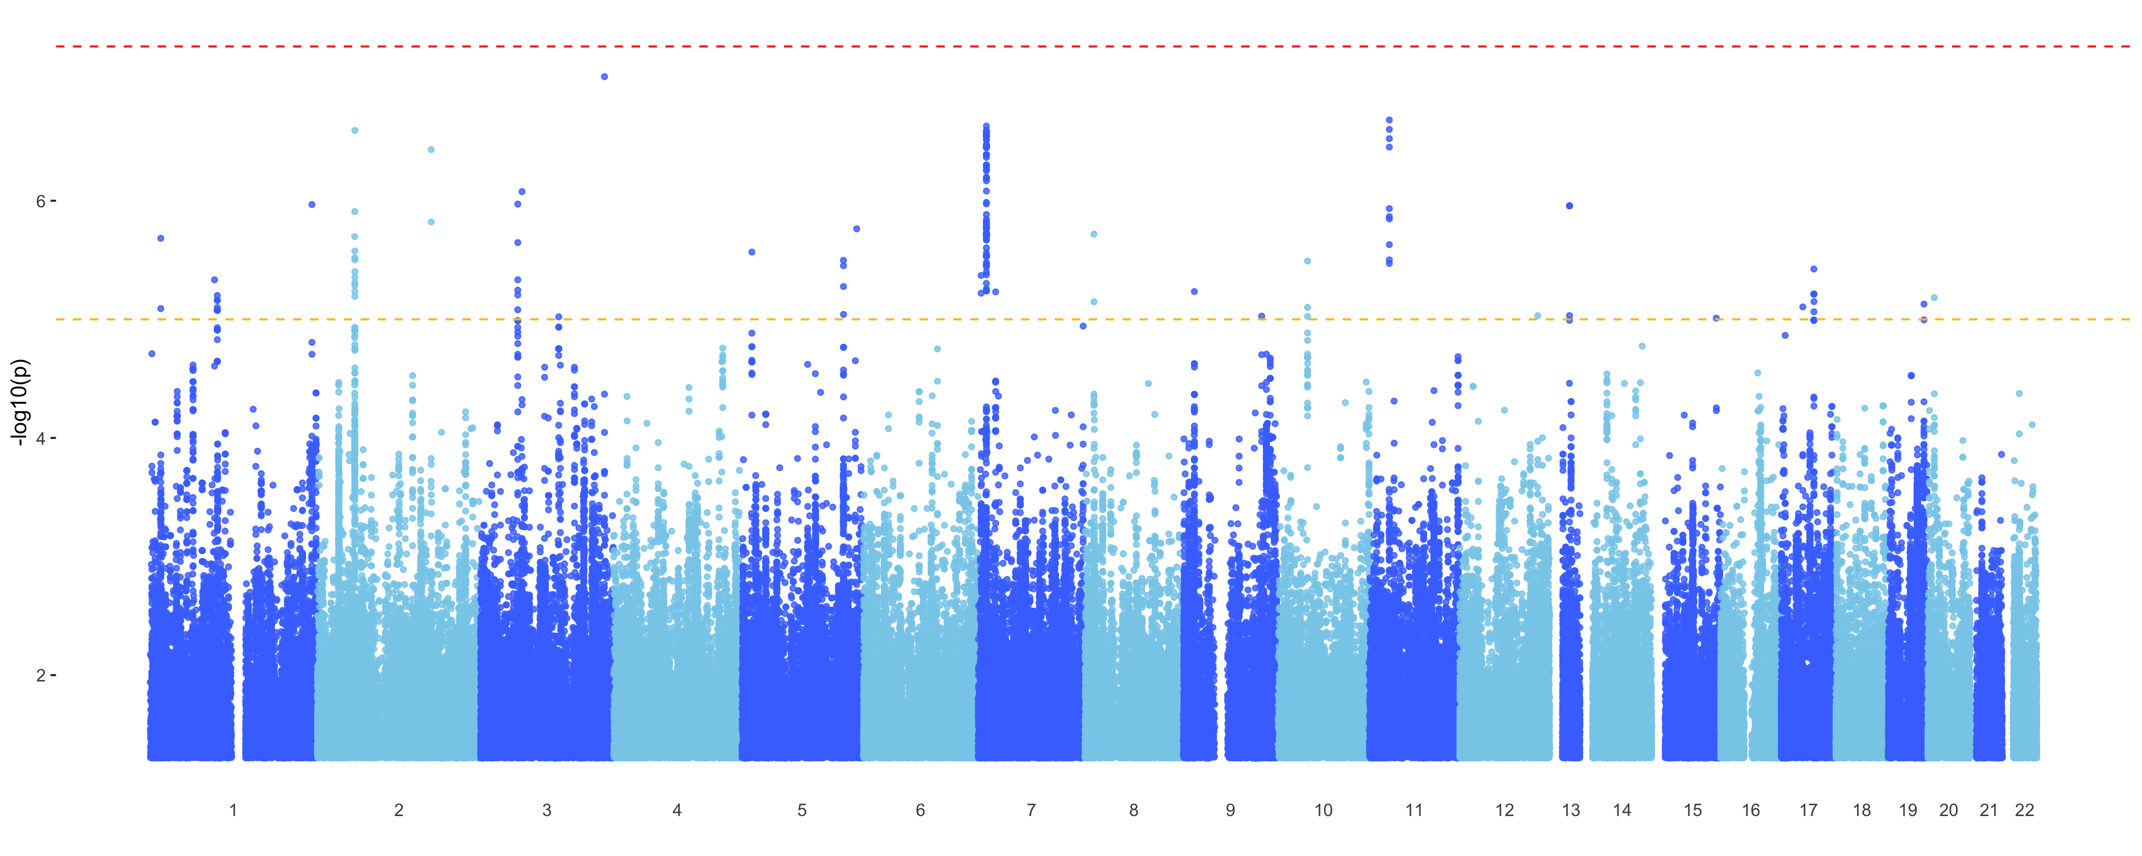
GWAS (EMMAX) of distance from each archetype for all patients (cases and control)
Archetype_3

Slide 28
Shared mapped genes between different phenotypes
C2orf48: ncRNA
SSBP3: transcription factor; collagen(?)
RGMB: neuronal adhesion/development
ANK1: cell motility/activation/proliferation
SLC14A2: cell adhesion; glucose/urea TM-transport
CSMD1: brain (cerebellum, hippocampus); glucose homeostasis, startle response
KCNA4: Potassium channels
RGS7: G-protein; K channels, signal transduction,
TMEM106B: transmembrane; interacts with apoe
BNC2: transcription factor; skin pigmentation, scoliosis
DLC1: cytoskeletal reorganization; tumor supressor
Notes:
I took all the suggestive snps and ran them through FUMA to map them to genes, and then, following Nikhil’s example, I generated a network from these genes to see the structure of overlap between the different phenotypes.
So here I combine the mapped genes from my archetype analysis with those from Nikil’s analysis for the subtypes as well as clinical phenotypes (in red)
Looking at the architecture without submodules first:
In accord with what we found based on the gene expression alone:
Subtype A overlaps with both archetype 1 and 2, while subtype B overlaps with archetype 3.
Archetypes don’t overlap directly among themselves - archetype 1 doesn’t overlap directly with archetype 2 and neither of them overlaps with archetype 3. Same for the subtypes (which we already knew from Nikhil’s work).
Clinical phenotypes don’t overlap much either. But, looking at archetypes instead of subtypes reveals a bit more overlap with clinical phenotypes:
Breaking down subtype A into two archetypes reveals overlap between archetype 2 and clinical diagnosis through CSMD1 that wasn’t there when mapping subtype A
CSMD1: Protein coding; expressed in the brain more than other tissues, including cerebellum, substantia nigra, hippocampus and fetal brain; glucose homeostasis, startle response
Archetype 3 also reveals one gene that overlaps with CERAD score – BNC2 – in addition to DLC1 that overlaps with Braak stage that was already by subtype B
Two genes are shared between subtype A and archetype 1: C2orf48, SSBP3; both rather obscure
Three genes are shared between subtype A and archetype 2: RGMB, ANK1, SLC14A2; all related to membrane integrity and transmembrane function somewhat in accord with submodules being about glial cells function and proliferation
Three genes are shared between subtype B and archetype 3: RGS7, KCNA4, and TMEM106B; all highly expressed in the brain and involved in potassium channel and neuronal signal transduction in accord with this being the neuronal subtype based on the submodules (yellow_1) and GO annotations.
TMEM106B is well known to pop up in LOAD GWAS and enhances risk of APOE

Slide 29
Shared mapped genes between different phenotypes
Notes:
Adding submodules to the picture:
For clarity I removed the genes that are not shared with at least one of the other phenotypes.
As Nikhil already found in his work, the submodules are all over the place, overlapping with archetypes and subtypes that are otherwise unassociated, but not much with clinical phenotypes.
Yellow_1 overlaps a lot with archetype_3, which is in accord with the gene expression data. same for brown_1 and yellow_2 overlapping with archetype 2, but otherwise it's not really in accord with the gene expression profiles.
Interestingly, archetype 3 overlaps with the submodules more than subtype B even though subtype B was more directly derived from the submodules. Particularly, it reveals 3 new genes that are joined between archetype 3 and two or more submodules:
CERS6: phospholipid activity; neuronal TM signal transduction; PD
PNPT1: oxidative phosphorylation; mtRNA metabolism
PTPRG: protein dephosphorylation; TM signal transduction; neuronal development; cellular processes (PTPN5)
https://www.ncbi.nlm.nih.gov/pubmed/28527217
In addition, KCNA4 and TMEM106B are even more of a hub when the submodules are included.
CNTNAP5: neurexin family; neuronal cell adhesion and intercellular communication; epidermal growth factor; in accord with the other genes associated with archetype_2

Slide 30
Conclusions:
Archetype analysis allowed stratifying patients into three classes instead of two
While archetype 1 and 3 largely correspond to subtype A and B, respectively, archetype 2 is more mixed, including more ”other” (MCI) cases
Archetypes overlap with clinical phenotypes in their mapped genes more than subtypes do
Archetype 3 overlaps with the submodules more than subtype B does
New genes to consider for the mice models? Possibly related to metabolism and liver function

Slide 31
Hart, Y., Sheftel, H., Hausser, J., Szekely, P., Ben-Moshe, N. B., Korem, Y., … Alon, U. (2015). Inferring biological tasks using Pareto analysis of high-dimensional data. Nature Methods, 12(3), 233–235. https://doi.org/10.1038/nmeth.3254
Shoval, O., Sheftel, H., Shinar, G., Hart, Y., Ramote, O., Mayo, A., … Alon, U. (2012). Evolutionary Trade-Offs, Pareto Optimality, and the Geometry of Phenotype Space. Science, 336(6085), 1157 LP-1160. https://doi.org/10.1126/science.1217405
Korem, Y., Szekely, P., Hart, Y., Sheftel, H., Hausser, J., Mayo, A., … Alon, U. (2015). Geometry of the Gene Expression Space of Individual Cells. PLOS Computational Biology, 11(7), e1004224. https://doi.org/10.1371/journal.pcbi.1004224
Sheftel, H., Shoval, O., Mayo, A., & Alon, U. (2013). The geometry of the Pareto front in biological phenotype space. Ecology and Evolution, 3(6), 1471–1483. https://doi.org/10.1002/ece3.528

Slide 32
Notes:
Relaxing the assumption that a task is represented by a point rather than a region

